Slide 1

WNE UW
Risk and uncertainty
Topic 6b Part 2
Markov chain
Notes:
1

Slide 2
Intro
The popularity of Markov processes for analyzing risky situations is amazing (https://chatgpt.com/share/67630e05-549c-8010-af8c-42d32b9b033f). It is worth to know the powerful tool. We will focus on the Markov chains model. It is a good example of how to model situations that seem random and unpredicted.

Slide 3
Intro
Problem: I would like to know how many lecture materials I should prepare, i.e., how many students will be in my lecture after 10 weeks and how many copies to make. How can I model the uncertain demand for the copies? A more professional name for the problem: Customer Churn or Retention Model :)
I can count the number of students at the beginning of the lectures, estimate the flow of students, extend my observation to the future (Markov chain), and find the steady-state of the model. How do I do it?

Slide 4
Assumptions
1) Time is discrete --> applied microeconomics lectures every Friday
0
1
…
t
t +1
…
2) Limited number of states
PRSNT -- the student is present on the lecture
ABSNT -- the student is absent
3) We know/estimate the probabilities of changing the state from the period t to t +1
→ We can estimate the transition matrix

Slide 5


The transition matrix
0.15
PRSNT _{t} ABSNT_{t}
0.85
0.9
ABSNT
0.8
PRSNT _{t+1}
ABSNT _{t + 1}
PRSNT
$$P= \left[\begin{matrix}0.85 & 0.1 \\ 0.15 & 0.9\end{matrix}\right]$$
0.1
t +1 | t
Was present | 0.85 will be present 0.15 will be absent
Was absent | 0.9 will be absent 0.1 will be present
PRSNT _{t+1} ABSNT _{t+1}
PRSNT _{t}
ABSNT _{t}
Alternative notation
$$P= \left[\begin{matrix}0.85 & 0.15 \\ 0.1 & 0.9\end{matrix}\right]$$

Slide 6



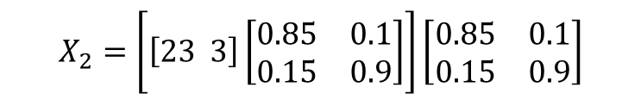
Simulation solution
If we know the initial state X₀ – number of students (proportion) on the first lecture, we can define the number of students on k lecture.
  Simulation solution
  Analytical solution – solving system of equations
$$X_{0}= \left[23 3\right]$$
X₀
$$X_{1}=[23 3]\left[\begin{matrix}0.85 & 0.1 \\ 0.15 & 0.9\end{matrix}\right]$$
X₀
X₁
$$X_{2}=\left[\left[23 3\right]\left[\begin{matrix}0.85 & 0.1 \\ 0.15 & 0.9\end{matrix}\right]\right]\left[\begin{matrix}0.85 & 0.1 \\ 0.15 & 0.9\end{matrix}\right]$$
X₀
X₁
X₂
$$X_{t}={\left[23 3\right]P}^{t}$$

Slide 7
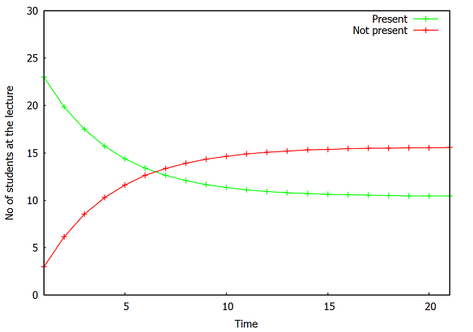
Simulation solution
Find the number of students on the 2, 3 and 13 lectures. Change the proportion of students in the first lecture X_0: matrix ([23], [3]);
kill(all)$
load(draw)$
P : matrix([0.85, 0.1], [0.15,0.9])$
X_0: matrix([23], [3])$
((P^^2).X_0)[1][1]$
present:''makelist( (P^^i.X_0)[1][1],i, 0, 20,1)$
not_present:''makelist((P^^i.X_0)[2][1],i, 0, 20,1)$
draw2d(
xlabel = "Time",
ylabel = "No of students at the lecture",
color = green,
key = "Present",
yrange= [0,30],
points_joined = true,
points(''present),
color = red,
key = "Not present",
points(''not_present))$

Slide 8
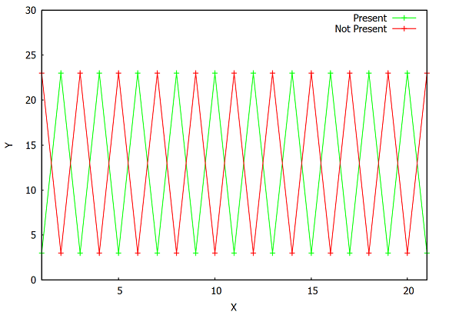
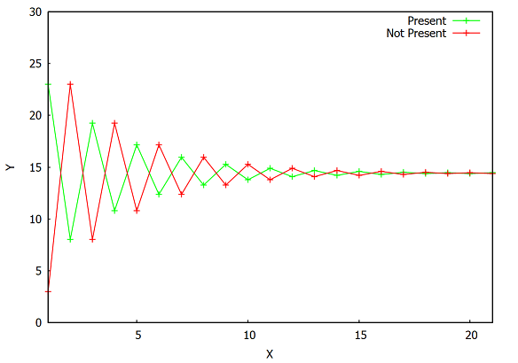
Simulation solution
What will happen when P matrix looks like:
P: matrix([0,1],[1,0]);
P : matrix([0.25,0.75],[1,0]);

Slide 9
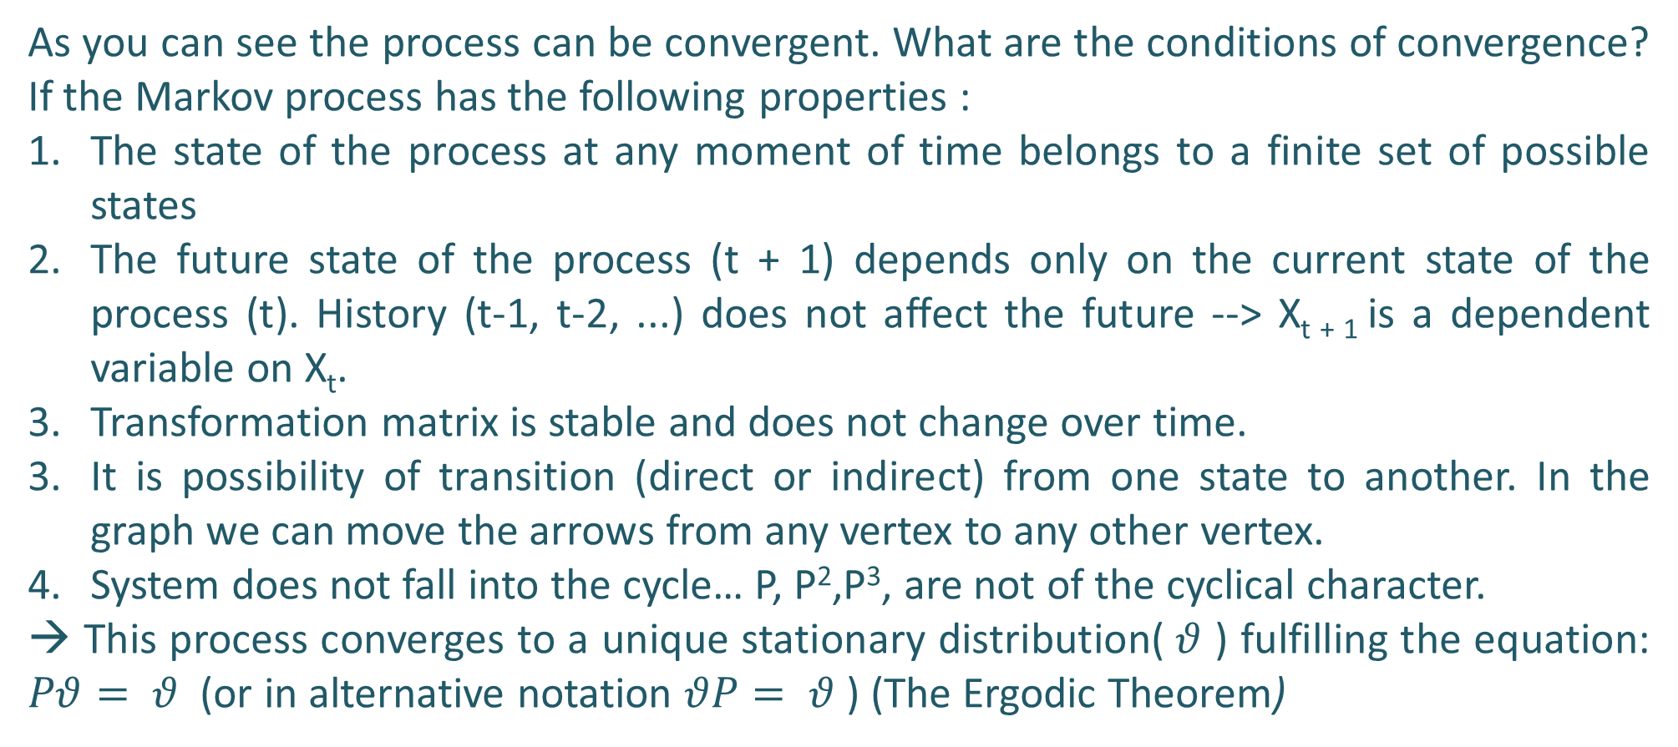
Analytical solution
As you can see the process can be convergent. What are the conditions of convergence? If the Markov process has the following properties :
The state of the process at any moment of time belongs to a finite set of possible states
The future state of the process (t + 1) depends only on the current state of the process (t). History (t-1, t-2, ...) does not affect the future --> X_{t + 1} is a dependent variable on X_{t}.
Transformation matrix is stable and does not change over time.
It is possibility of transition (direct or indirect) from one state to another. In the graph we can move the arrows from any vertex to any other vertex.
System does not fall into the cycle… P, P²,P³, are not of the cyclical character.
→ This process converges to a unique stationary distribution($θ$ ) fulfilling the equation: $Pθ= θ$ (or in alternative notation $θP= θ$ ) (The Ergodic Theorem)

Slide 10
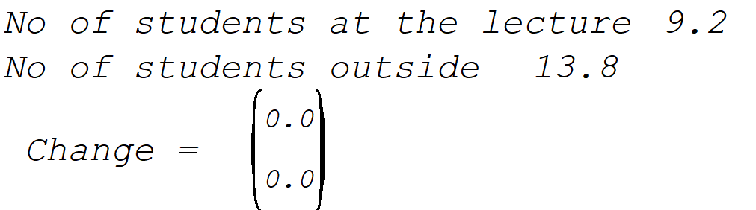
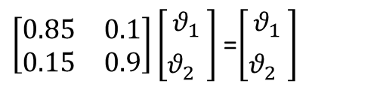
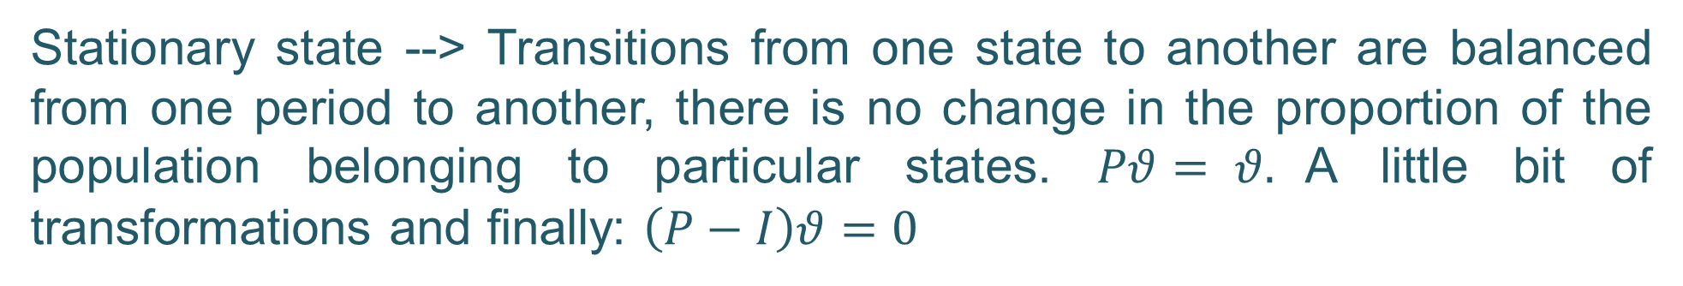
Analytical solution
Stationary state --> Transitions from one state to another are balanced from one period to another, there is no change in the proportion of the population belonging to particular states. $Pθ= θ.$A little bit of transformations and finally: $\left(P−I\right)θ=0$
kill(all)$
load(draw)$
P : matrix([0.85, 0.1], [0.15,0.9]);
v:matrix([v1],[v2]);
N: 23; /*Number of students */
eq1: (((P) - ident(2)).v)[1][1] = 0$
eq2: (((P) - ident(2)).v)[2][1] = 0$
eq3: v1+v2 = 1$
solve([eq1,eq2,eq3],[v1,v2])$
output:%[1]; /*output is a proportion vector*/
v1:23*rhs(output[1])$
v2:23*rhs(output[2])$
print("No of students at the lecture", float(v1))$
print("No of students outside ", float(v2))$
print (" Change = ", ''P.''v - ''v)$
Under the assumption all the proportions sum up to 1
v1 + v1 = 1
$\left[\begin{matrix}0.85 & 0.1 \\ 0.15 & 0.9\end{matrix}\right]\left[\begin{matrix}θ_{1} \\ θ_{2}^{}\end{matrix}\right]$ =$\left[\begin{matrix}θ_{1} \\ θ_{2}^{}\end{matrix}\right]$

Slide 11
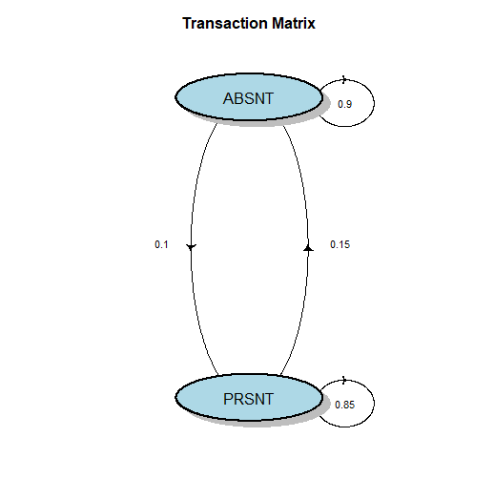
Analytical solution
In R
###### Start of Section 0 ##################################################
###### Check, installation and loading of required packages #######
requiredPackages = c("diagram", "markovchain" ) # list of required packages
for(i in requiredPackages){if(!require(i,character.only = TRUE)) install.packages(i)}
for(i in requiredPackages){if(!require(i,character.only = TRUE)) library(i,character.only = TRUE) }
par(mfrow=c(1,1))
P <- matrix(c(0.85, 0.15,0.1,0.9 ), nrow = 2 , byrow=FALSE )
x0 <- matrix(c(200, 30), ncol = 2)
stany <- c("PRSNT","ABSNT")
row.names(P) <- stany;
colnames(P) <- stany
plotmat(P,lwd = 1, box.lwd = 2,
cex.txt = 0.7,
box.size = 0.1,
box.type = "circle",
box.prop = 0.4,
box.col = "light blue",
arr.length=.2,
arr.width=.2,
self.cex = .4,
self.shifty = -.01,
self.shiftx = .13,
main = " Transaction Matrix ")

Slide 12
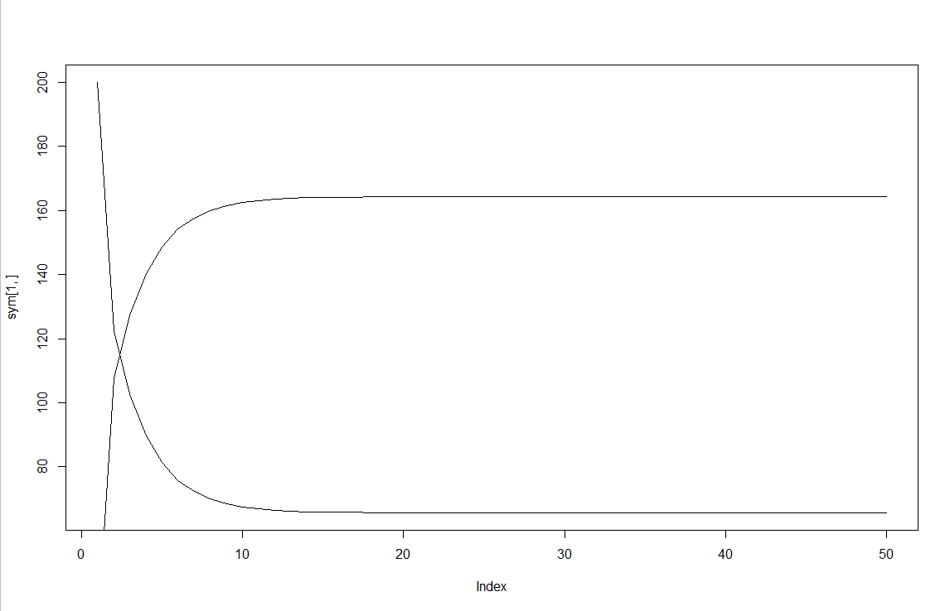
Analytical solution
In R
markov_chains<- function(P, x0, iter ){
wynik <- matrix(0, nrow = nrow(P), ncol = iter )
p_pow <- P
wynik[,1] <- x0
for(i in 2:iter) {
p_pow <- P %*% p_pow # mnożenie macierzy
wynik[,i] <- x0 %*% p_pow
}
return(wynik)
}
sym <- markov_chains(P, x0, 50 )
plot(sym[1,], type = "l")
lines(sym[2,])

Slide 13
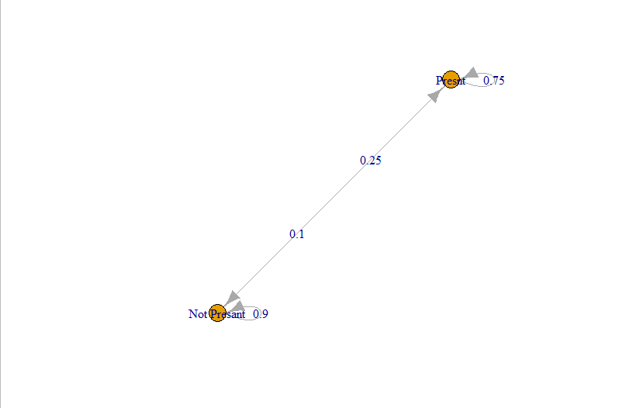
Analytical solution
In R
Unnamed Markov chain
A 2 - dimensional discrete Markov Chain defined by the following states:
PRSNT, ABSNT
The transition matrix (by rows) is defined as follows:
PRSNT ABSNT
PRSNT 0.75 0.25
ABSNT 0.10 0.90
# A new markovchain object ::markovchain
PMC<-new("markovchain",
states=stany,
transitionMatrix=
P)
PMC
plot(PMC)
steadyStates(PMC) # proportions
steadyStates(PMC)*230 # numbers
steadyStates(PMC) # proportions
PRSNT ABSNT
[1,] 0.2857143 0.7142857

Slide 14

Applications
Where to apply this type of modelling?
To model production processes
For modeling of the labor market instead of the states IS / NOT, we can type WORK / NOT WORK
The stock market through moving boom, recession, stabilization
Political transition from the state of Democracy, Partial democracy, Dictatorship
http://www.youtube.com/watch?v=7dsfNFA9LRE It is part of the course: https://www.coursera.org/course/modelthinking
Social learning model (DeGroot)
Finance

Slide 15
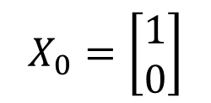
Applications/ old exam
Similar to Markov chains is the simple model of social learning (DeGroot). We have only change the interpretation of the previous model.
X0 is a vector of initial believes ( 0 – do not believe, 1 believe in climate change) or probability that we believe the statement is true.
The transaction matrix is now an influence (communication, trust) matrix. The graph shows ow agents influence each other. Agents do believe mainy in himself/herself (0.8 and 0.9 ) The influence by other is a week (0.2, 0,1).
We can find how agent by social learning (communication) changing their beliefs. It depends on the network structure and their initial beliefs.
$$X_{0}=\left[\begin{matrix}1 \\ 0\end{matrix}\right]$$
0.2
0.8
0.9
Agent 2
0.8
Agent 1
0.1

Slide 16
Applications/exam
The model of social learning was a part of the exam task about the vaccination. The main problem of vaccination is herd immunity. Some people are keen on vaccinate (x = 1), some have a little doubts(x = 0.6), some bigger (x = 0.3) and some are completely sceptic (x = 0).
The communication between the groups can change the overall willingness to the vaxination. How information/ideological bubbles can influence our beliefs? It is possible to simulate/forecast this type of behaviours using the simple model?

Slide 17
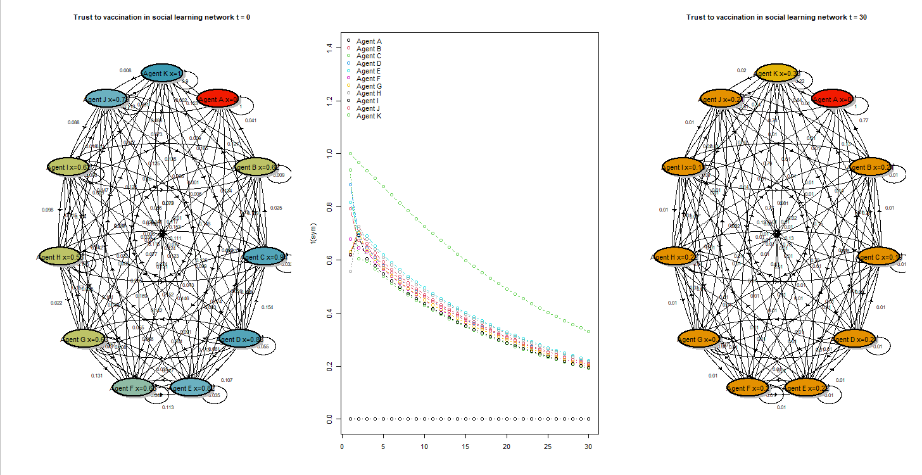
The model of social learning Troll in the network
The DeGroot model shows the serious threat of fake news. If the troll acts as a constant source of fake news (algorithmic or paid troll) in the network, then agents start to believe in fake news and after a series of interactions, they take the news as their own.
Troll (A)
* does not believe in vaccines x = 0
* not interested in the opinion of others (faith in your message = 1)
Even an institution fighting against fake news is not able to change this trend. The message of the institution (K) is modified by others (belief in your message -> 0.9) - believes in vaccines x = 1.

Slide 18
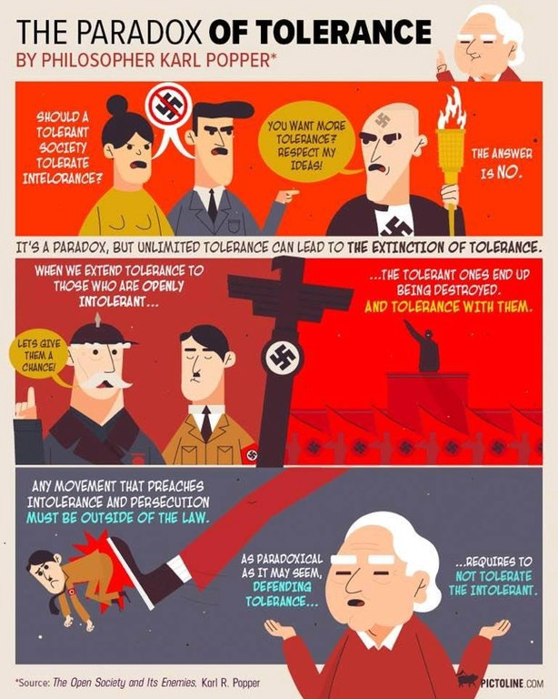
The model of social learning Troll in the network
Karl Popper's ethical / philosophical paradox emerges:
“in order to maintain a tolerant society, the society must be intolerant of intolerance.”

Slide 19
Finance
Typical for the financial market is using rating to quickly evaluate the relative risks of assets held in a portfolio. Rating firms add labels to each of assets, like these AAA, AA,…..D, (see Fitch Ratings*). We can construct the transition matrix based on historical data: Probability that asset from the group change their ratings / their labels.

Slide 20
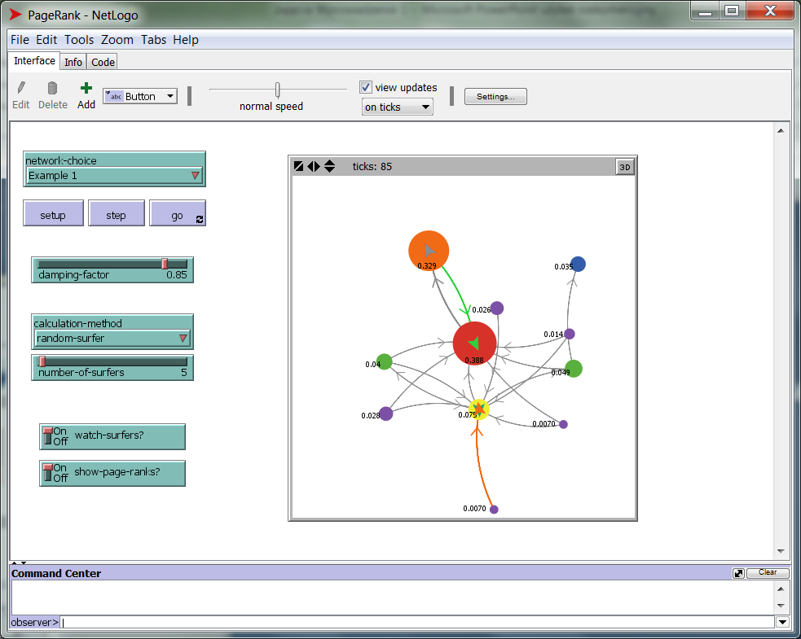
Markov chain: the most famous example
You can estimate the probabilities of the P matrix.
Problem: how to rank www page?
Larry Page, Sergey Brin, (Google)
Example : PageRank
We send robots that pass between pages. Counts the number of visits to that page relative to all visits.

Slide 21
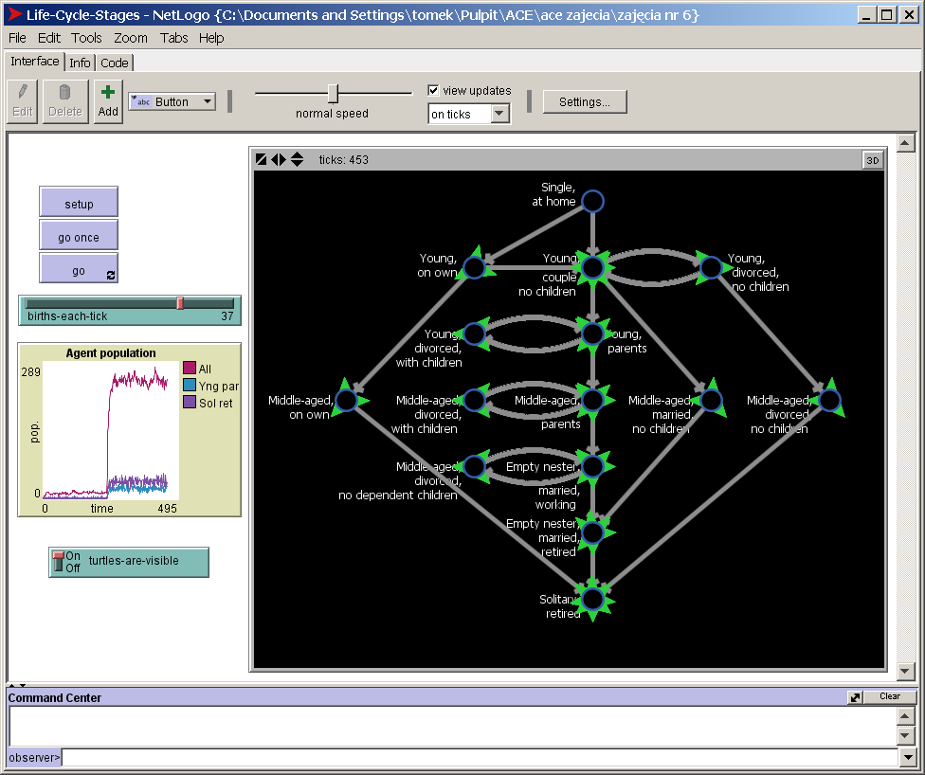
Finite automats
Life Cycle based on: Jobber (1998) in "Principles and Practice of Marketing" Teahan, W. J. (2010). Artificial Intelligence. Ventus Publishing Aps.
Model illustrating the use of finite automata in "customer management".
Agents "enter" the system and follow on paths.
Where the path is split, probability determines the next path.
The last state represents exit from the system.
File: Life Cycle Stages.nlogo

Slide 22
Markov chain --> homework before exam -->
The main problem in the exam tasks will be similar to the previous ones: converting market information into a suitable model. There will be modifications to these tasks on the actual exam.
It’s important that you prepare by learning how to construct the matrix P and the vector v.
During the exam, you may use any resources you like—my codes in R or MAXIMA, Excel, and even the internet.

